Slide 1
Notes:
Use this as Slide 1

Slide 2
WPCC Member Survey
Catherine Holliday
Centre for Community-Driven Research
on behalf of the WPCC Steering Committee
3 May 2017
Notes:
Use this as your second slide.

Slide 3
South Africa
Slovenia
BRAZIL
CYPRUS
AUSTRALIA
SPAIN
ARGENTINA
CANADA
Sweden
FRANCE
EUROPE
WPCC
United
THIS
IS
YOUR
Kingdom
United
States of
America
ITALY
MEXICO
BELGIUM
Greece
JAPAN
Portugal
SLOVAKIA
GERMANY
HUNGARY
AUSTRIA

Slide 4
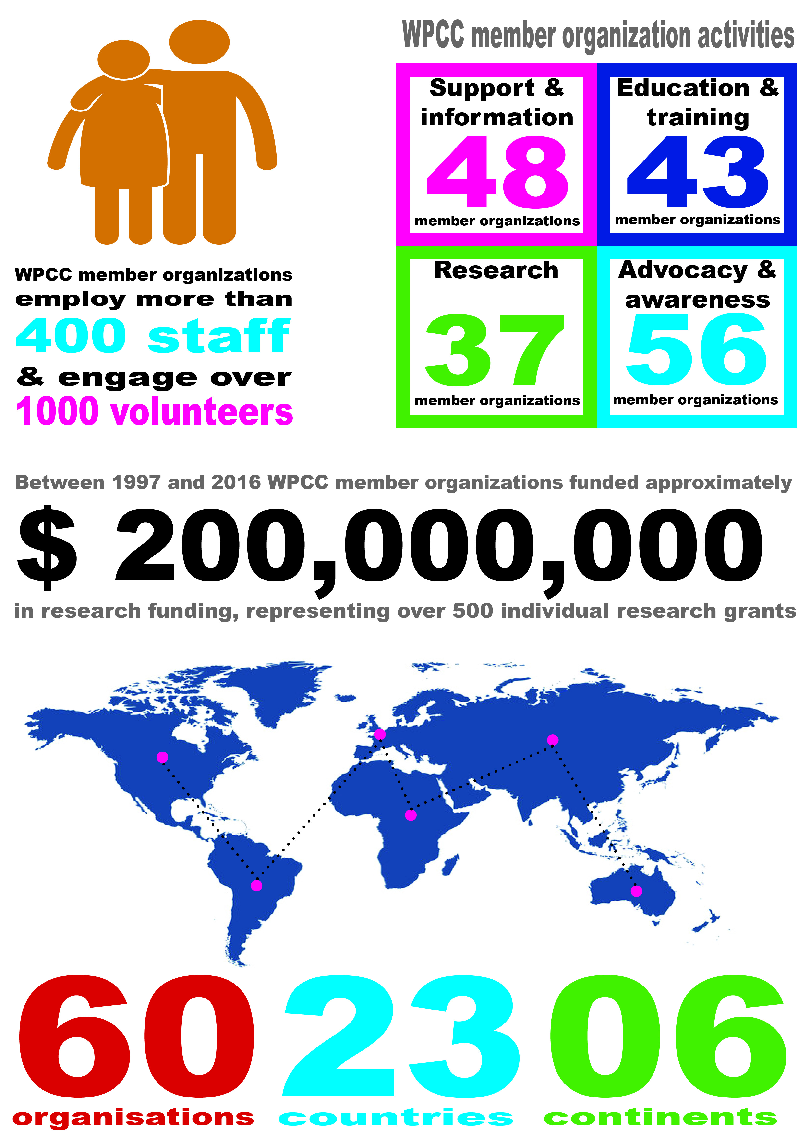
WPCC members

Slide 5
WPCC areas of work
Advocacy, Awareness and Fundraising
Services and Support (including information)
Education and Healthcare Professional Training
Research
56
48
43
37
Raising public awareness about pancreatic cancer
49
Providing support services for patients, their families/carers
Participating in pancreatic cancer educational activities
Funding pancreatic cancer research projects
38
43
32
Recruiting volunteers/advocates to raise awareness
31
Offering financial support
13
Training healthcare professionals
Undertaking or commissioning research to improve services
17
20
Participating in advocacy or campaigning activities
30
Organizing fundraising events
37

Slide 6
Advocacy & awareness How WPCC members advocate
38
29
29
27
20
Social media
Media stories
Face-to-face
Leaflets/pamphlets
Advertising & PR

Slide 7
Advocacy & awareness Opportunities to communicate online
Family/Care-giver
Experience
Webinars &
Blogs
Community forums/
Information days
Patient experience
Live chats
24
16
13
5
1

Slide 8
Support & information Direct clinical services
9
Counseling, from psychologists or other trained therapists
Nursing support
Dietary or nutritional support, from trained dieticians or nutritionists
Complementary therapy
7
3
7

Slide 9
Support & information
41 WPCC member organizations provide written information about pancreatic cancer
17 provide information
over the phone

Slide 10
Education & training
43 participate in educational activities
20 provide health professional training opportunities

Slide 11
Research funding
Biology
Etiology
Prevention
Early Detection
Treatment
Cancer Control
14
11
11
21
18
5

Slide 12
Clinical trials

Slide 13
Notes:
Use this as the last slide

